Slide 1

Hotel booking for a Resort Hotel & a City Hotel in Portugal
June 20th 2024

Slide 2

Introduction
There are 4 analysts deciphering data
Lavanya Bhanot
Deogratius Nteza
Xuan (Sam) Chen
Judy Pin
Lavanya
Notes:
Lavangia –introduction
Deo - explain the data

Slide 3

Data Explanation
Deo
Notes:
Deo

Slide 4

Agents Sammy

Slide 5
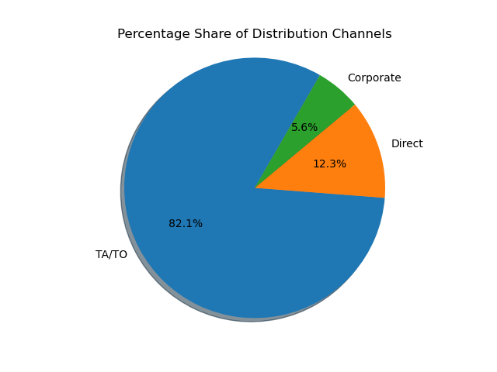

Slide 6
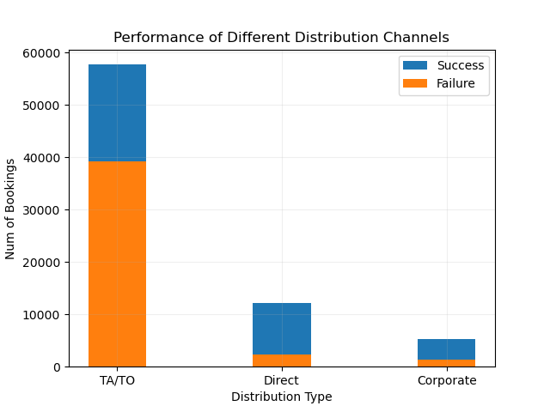

Slide 7
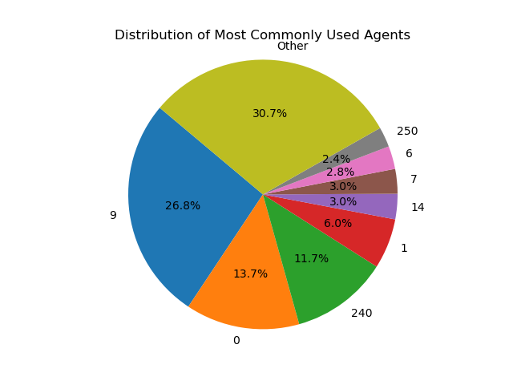

Slide 8
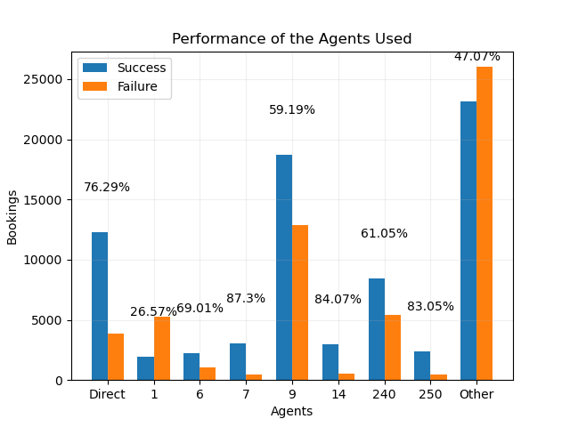

Slide 9

Spend Judy

Slide 10
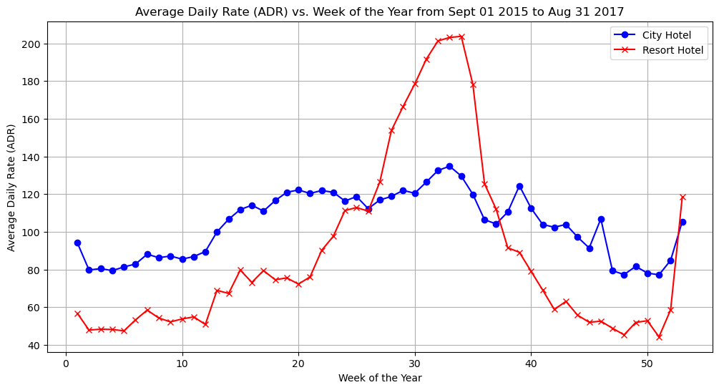

Slide 11
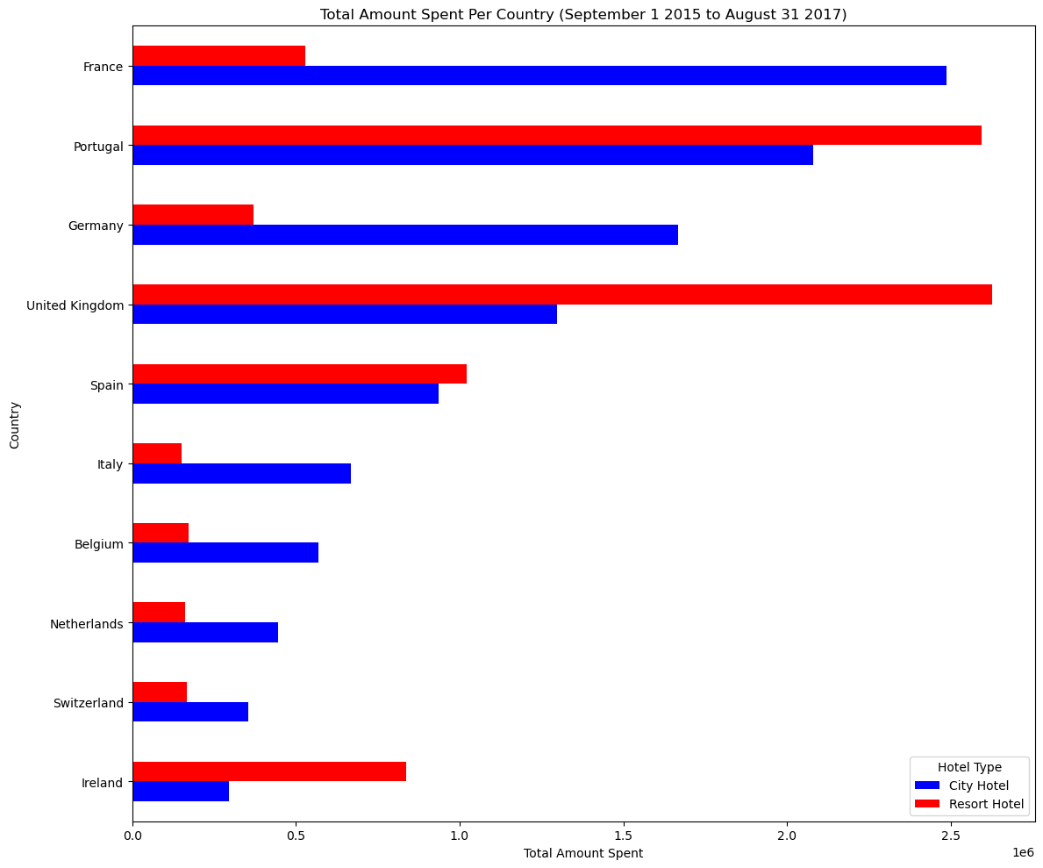

Slide 12
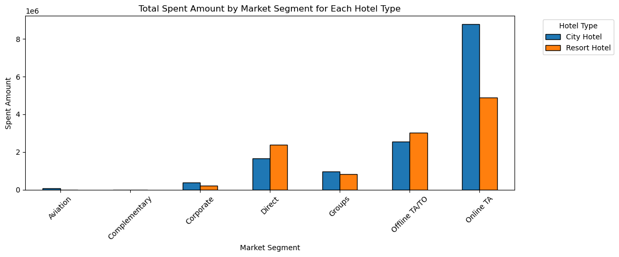

Slide 13
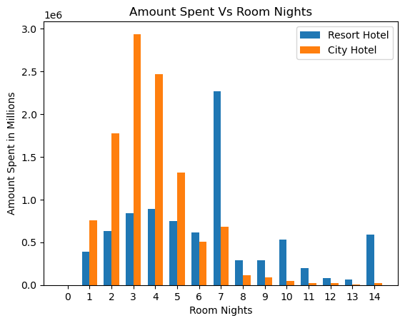

Slide 14
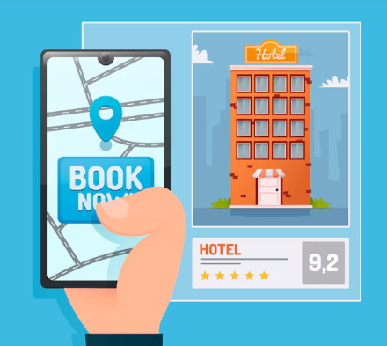
Room Types, Revenue and Cancellations Lavanya

Slide 15
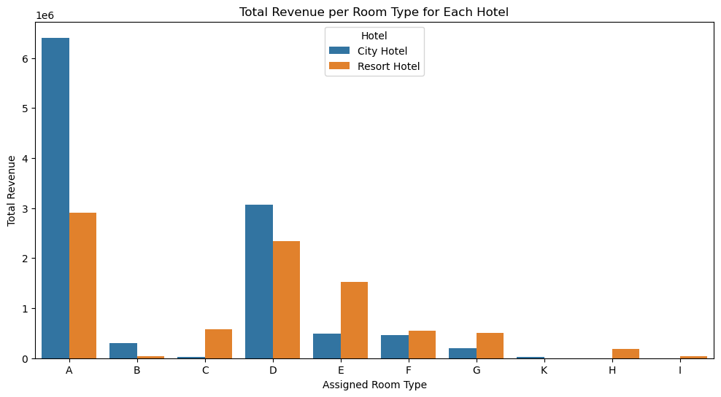

Slide 16
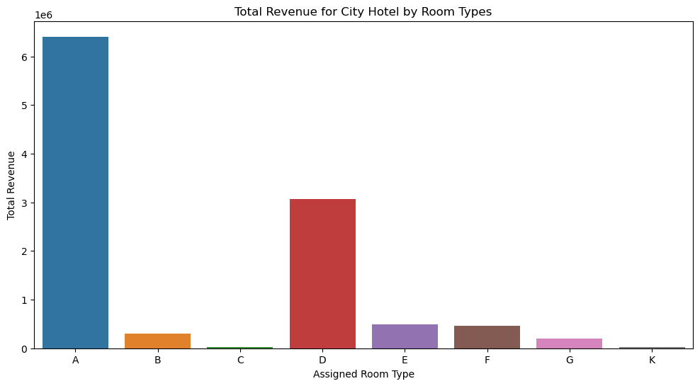

Slide 17
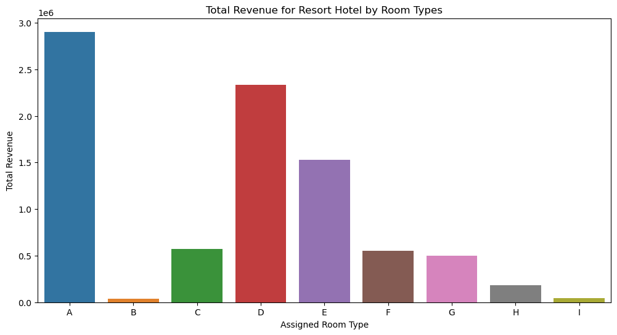

Slide 18
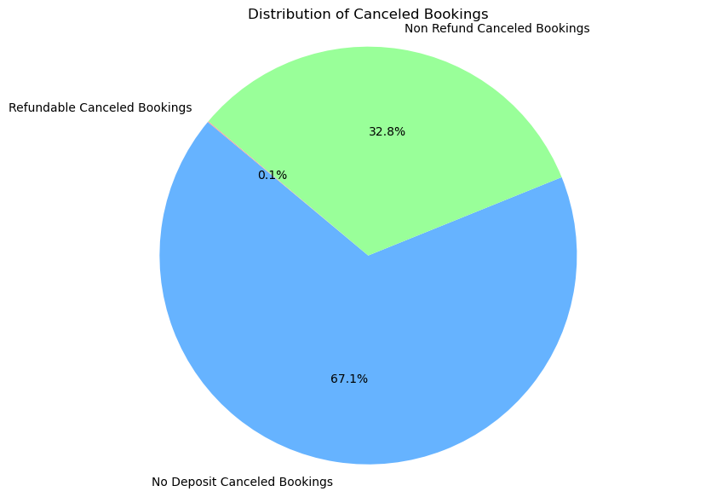
Total Canceled Bookings: 44224
Refundable Canceled Bookings: 0.08%
No Deposit Canceled Bookings: 67.14%
Non Refund Canceled Bookings: 32.77%

Slide 19
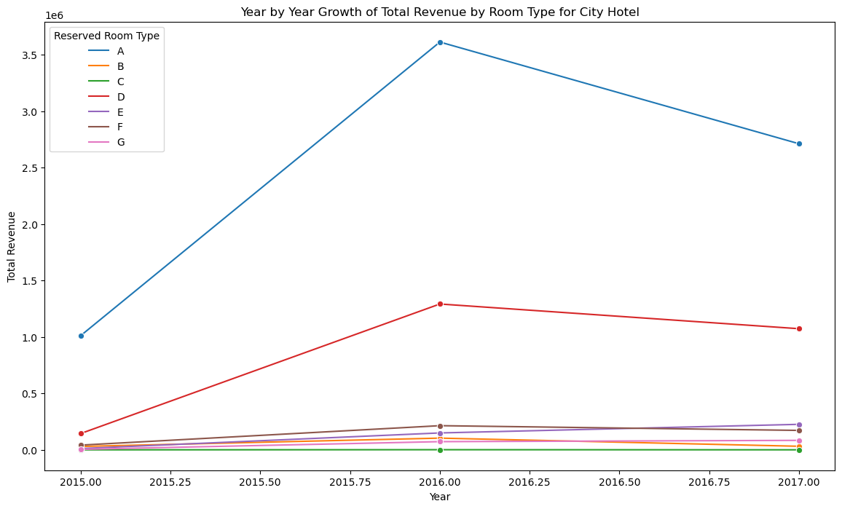

Slide 20
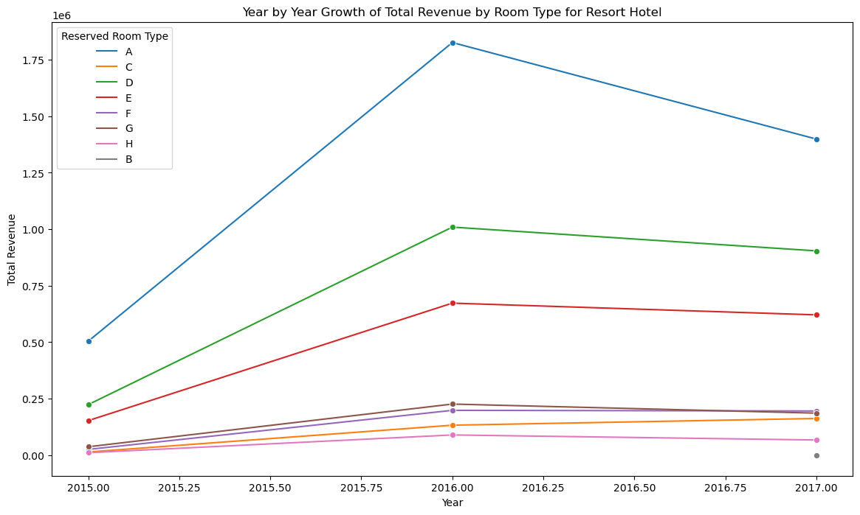

Slide 21
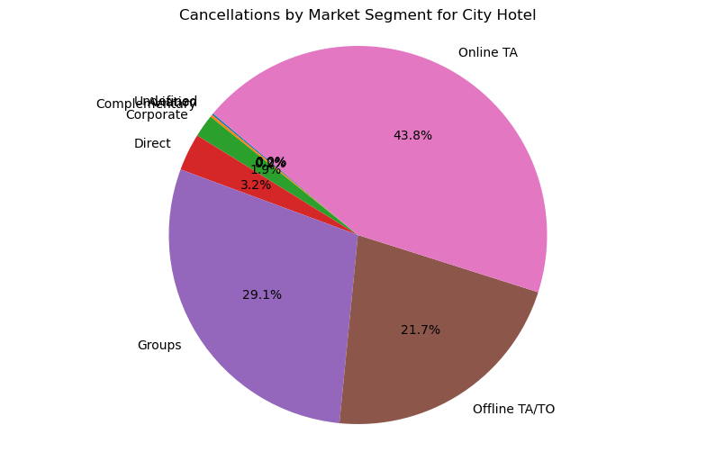

Slide 22
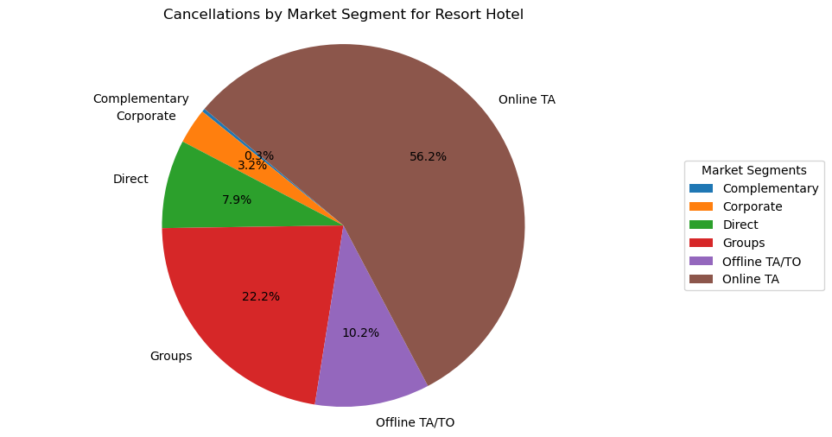

Slide 23
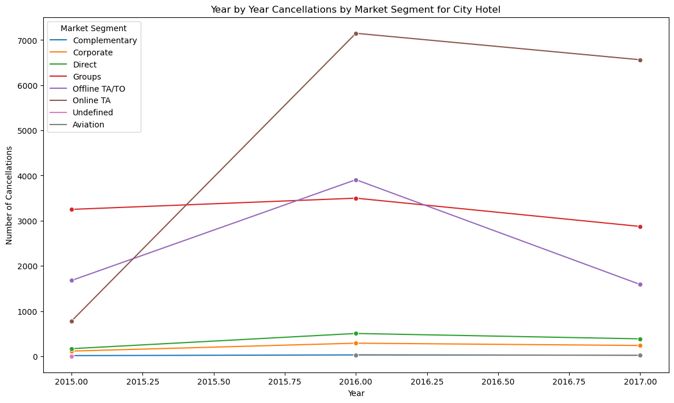

Slide 24
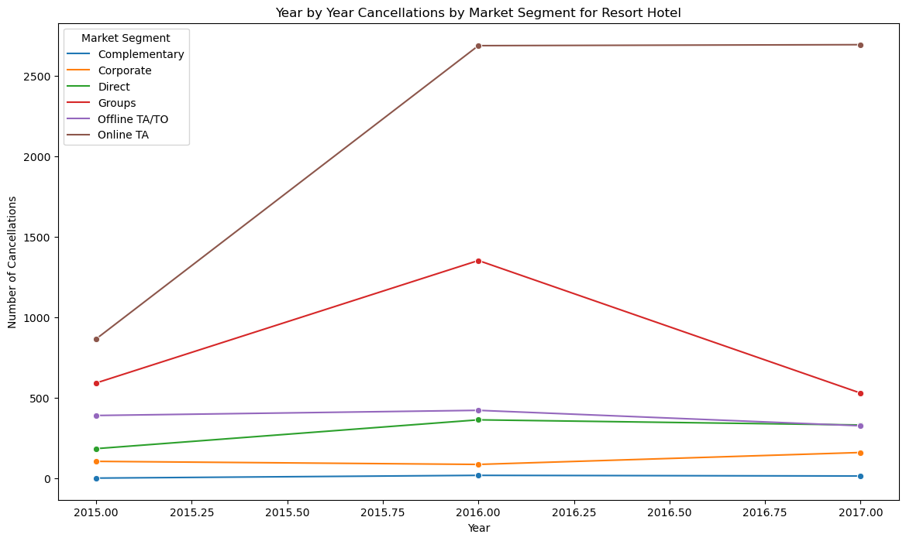

Slide 25
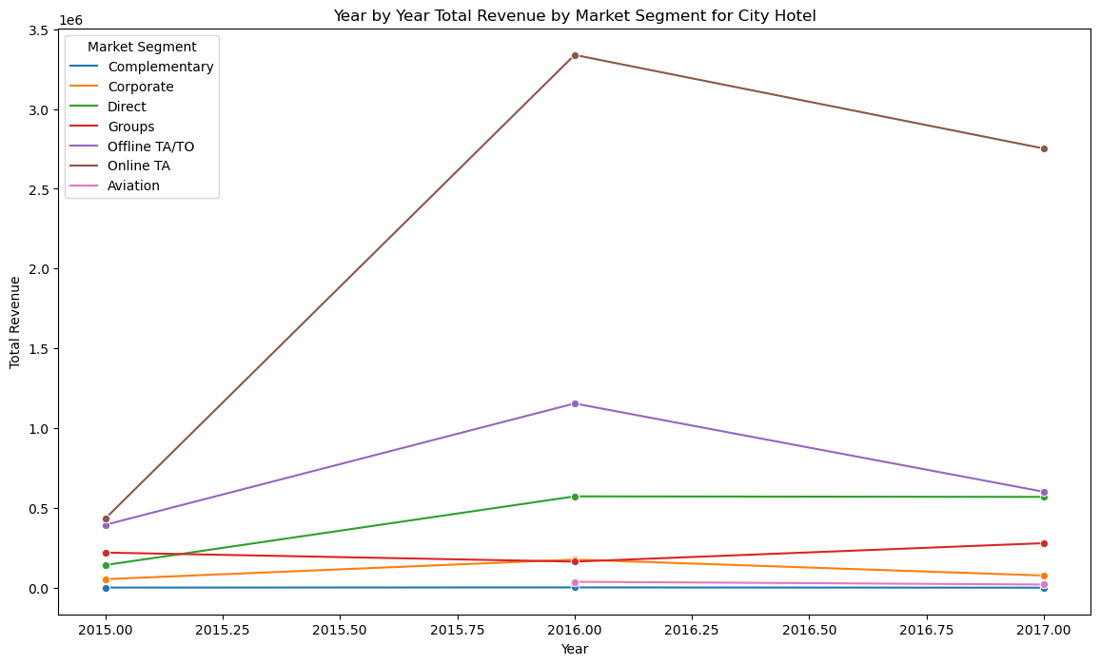

Slide 26
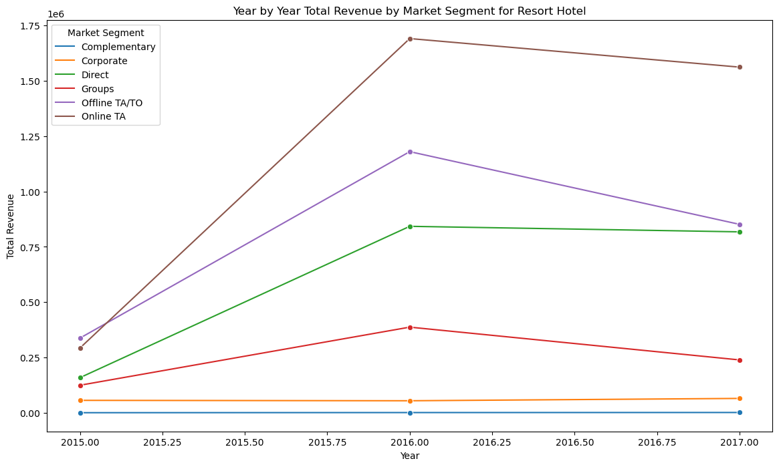

Slide 27

Geography Deo

Slide 28

Conclusion
Judy
Notes:
Judy - conclusion

